Slide 1
CCE DATA SCIENCE & MACHINE LEARNING
MAY 7TH, 2021
INTERNS: Justin Chow & Katherine Tatley
MANAGER: Kun Zan

Slide 2
01
02
03
FEATURE ENGINEERING
FEATURE SELECTION
MACHINE LEARNING MODEL BUILD
Pre-processing data with the idea of deploying the model
Select a group of variables, the most predictive ones.
Utilize the engineered data and pre-selected features

Slide 3
REMINDER
Objective: predict house prices is useful to identify fruitful investments or determine whether price advertised for a house is over or under-estimated.

Slide 4
“We aim to minimise the difference between the real price and the price estimated by our model.”
— CCE DATA SCIENCE & MACHINE LEARNING INTERN TEAM

Slide 5
FEATURE ENGINEERING
01
Pre-processing data with the idea of deploying the model

Slide 6
SEPARATE DATASET INTO TRAIN AND TESTING SET
How do we include some elements of randomness?
Answer: Setting the seed
Achieve reproducibility
You can test the data’s parameters clearly
Learn this parameter only from the train set.
And the most important thing: avoid over-fitting!

Slide 7

MISSING VARIABLES
CATEGORICAL
NUMERICAL
List categorical variables that contain missing values, print percentage of missing values, and replace them with a new label: “Missing”.
Added a binary missing value indicator variable and then replace the missing values in the original variables with the mode.

Slide 8
TEMPORAL VARIABLES
Capture elapsed times
Four variables that refer to the years in which the house or the garage were built or remodeled.
We captured time elapsed between those variables and the year in which the house was sold.
Numerical variable transformation
We observed that the numerical variables are not normally distributed.
We used log transformation to get a more Gaussian-like distribution.
Goal is to support the development of the linear machine learning model.

Slide 9
CATEGORICAL VARIABLES
Group those categories within variables that are present in less than 1% of the observations.
All values of categorical variables that are shaped by less than 1% of houses, they would be replaced by the string “RARE.”
Removing Rare Labels
Encoding of categorical variables: transform strings of the categorical variables into numbers by capturing monotonic relationship between the label and the target.

Slide 10
ONE-HOT ENCODING
Process of converting categorical data variables and prepare it for the predictive model.
Notes:
One hot encoding is useful for data that has no relationship to each other. Machine learning algorithms treat the order of numbers as an attribute of significance. In other words, they will read a higher number as better or more important than a lower number. While this is helpful for some ordinal situations, some input data does not have any ranking for category values, and this can lead to issues with predictions and poor performance. That’s when one hot encoding saves the day. One hot encoding makes our training data more useful and expressive, and it can be rescaled easily. By using numeric values, we more easily determine a probability for our values. In particular, one hot encoding is used for our output values, since it provides more nuanced predictions than single labels.

Slide 11
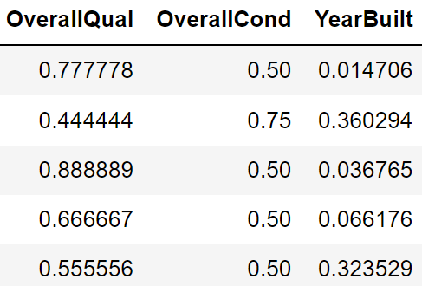
TARGET ENCODING
Converting categorical into numerical data.
Manually converting our data to numerical values includes two basic steps:
Integer Encoding
One-Hot Encoding
We removed the integer encoded variable and add a binary variable for each unique variable (i.e., Overall Qual).

Slide 12
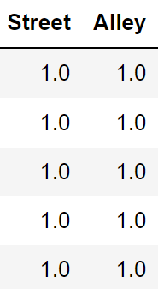
LABEL ENCODING
Converting categorical into numerical data.
Converting the labels into numeric form so as to convert it into the machine-readable form:
It assigns a unique number (starting from 0) for each class of data.
A label with high value may be considered to have high priority than a label having lower value.

Slide 13
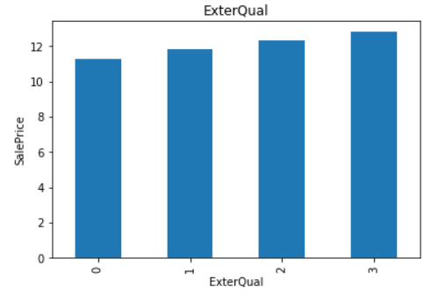
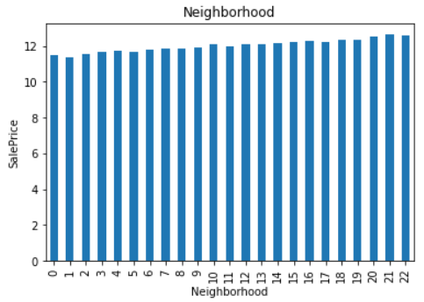
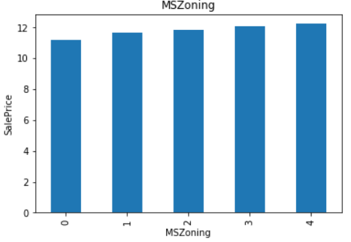
MONOTONIC RELATIONSHIP
SMALL
LARGE
MED
Notes:
The monotonic relationship is particularly clear for the variables MS Zoning, Neighborhood, and ExterQual. Note how, the higher the integer that now represents the category, the higher the mean house sale price (remember that the target is log-transformed, that is why the differences seem so small).

Slide 14
FEATURE SELECTION
02
Select a group of variables, the most predictive ones.

Slide 15
WHY DO WE SELECT VARIABLES?
PRODUCTION
MODEL PERFORMANCE
Fewer variables mean smaller client input requirements, and hence less code for error handling.
Fewer variables mean simpler, more interpretable, better generalizing models.

Slide 16
LASSO REGRESSION
Specify the model by selecting a suitable alpha (penalty). The smaller alpha at 0.005 means more features will be selected.

Slide 17
82
22
60
Total Features
Selected Features
Features with coefficients shrank to zero

Slide 18
MACHINE LEARNING MODEL BUILDING
03
Utilize the engineered data and pre-selected features.

Slide 19
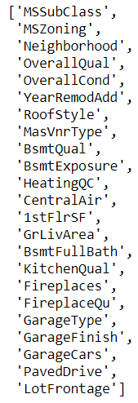




PRE-SELECTED FEATURES
We will add one additional feature to the ones we selected in the previous notebook: Lot Frontage. It needs this key feature engineering step as we want to discuss further during the deployment portion.

Slide 20
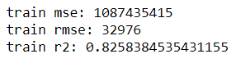
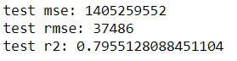
REGULARISED LINEAR REGRESSION: LASSO
TRAIN SET
TEST SET
Notes:
Evaluate the model: remember that we log transformed the output (Sale Price) in our feature engineering notebook (step 2). In order to get the true performance of the Lasso, we need to transform both the target and the predictions back to the original house prices values. We will evaluate performance using the mean squared error and the root of the mean squared error and r2.

Slide 21
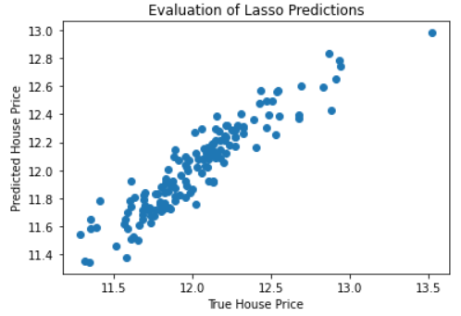
EVALUATION OF LASSO PREDICTIONS
When we evaluated our predictions respect to the real sale price, we can see that our model is doing pretty well at estimating house prices.

Slide 22
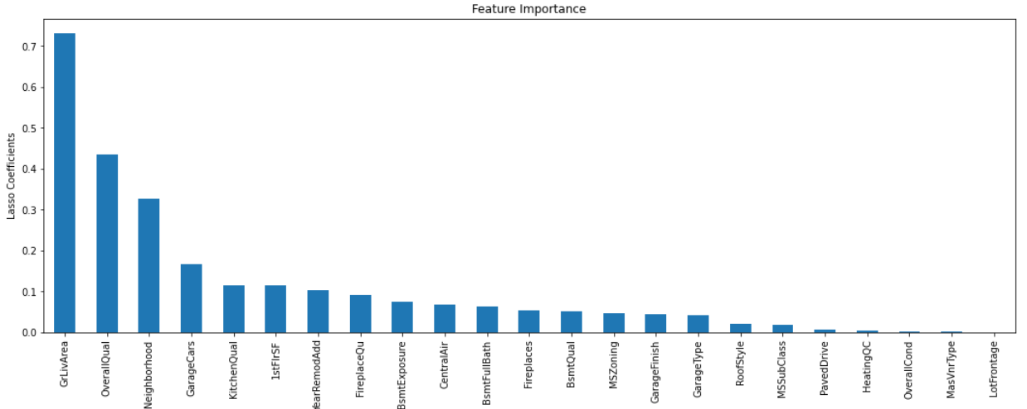
FEATURE IMPORTANCE
Notes:
Feature importance values indicate which fields had the biggest impact on each prediction that is generated by classification or regression analysis. Each feature importance value has both a magnitude and a direction (positive or negative), which indicate how each field (or feature of a data point) affects a particular prediction. The purpose of feature importance is to help you determine whether the predictions are sensible. We concluded that the relationship between the dependent variable house sale price and the important features such as above grade (ground) living area, overall quality, and neighborhood are supported by your domain knowledge the most.

Slide 23

SUMMARIZE WHICH STEPS WILL DEPLOY
Lasso Regression Models evaluate true performance of the model to accurately predict house prices compared to the average prices listed.

Slide 24
THANKS!
Do you have any questions?
Jchow2@scu.com
katherine.tately@gmail.com
kzan27@gmail.com

